Slide 1
Agile - Scrum
SurendraKC

Slide 2
Limitations of the Waterfall Model
Waterfall follows a linear sequential approach. Once a phase is done, you cannot go back.
Inflexibility to change – difficult to accommodate new requirements.
Late testing – issues found very late in the cycle.
Delayed customer feedback – customers see the product only at the end.
Risk of project failure if early assumptions are wrong.
Documentation-heavy – less focus on working software.
Not suitable for dynamic environments.

Slide 3
Introduction to Agile
Agile is a modern software development approach emphasizing flexibility, collaboration, and rapid delivery.
Focuses on iterative development, continuous feedback, and customer satisfaction.
Encourages cross-functional teams and adaptive planning.
Manifested through Agile Manifesto (2001) with 4 core values and 12 principles.
Core Values of Agile:
Individuals and interactions over processes and tools
Working software over comprehensive documentation
Customer collaboration over contract negotiation
Responding to change over following a plan

Slide 4
Core Values of Agile
Individuals and Interactions over Processes and Tools
Agile prioritizes people, communication, teamwork, and quick collaboration rather than depending too much on tools or strict processes.
Example
A QA finds a bug during testing. Instead of logging it in Jira and waiting for formal approval, the QA directly talks to the developer and gets it fixed quickly.
A team prefers daily stand-up discussions to solve blockers instead of relying heavily on email or documentation.
Value: Human communication solves problems faster than rigid procedures.
Working Software over Comprehensive Documentation
The main goal is to deliver working, usable software—not spending too much time creating long documents.
Example
Instead of writing a 50-page requirement document, the team delivers a working prototype in the first sprint and gathers customer feedback.
A product increment is tested and available for demo even if all documents are not fully written, as long as key notes exist.
Value: Customers get real value only when the software works, not from thick documents.

Slide 5
Core Values of Agile
Customer Collaboration over Contract Negotiation
Agile encourages continuous communication with customers and stakeholders instead of rigidly sticking to the contract.
Example
After building the first part of a feature, the customer wants a slight UI change. The Agile team discusses and adjusts without saying “It’s not in the contract.”
Regular sprint reviews help the customer see the product and request changes early.
Value: Working closely with customers ensures the product meets real needs.
Responding to Change over Following a Plan
Agile accepts and welcomes changes—even late in development. Plans are important, but adapting quickly is more important.
Example
The team planned to build Feature A in Sprint 2, but a high-priority customer issue arises. The team adjusts and works on the new requirement.
If market conditions change or a competitor releases something new, the product backlog is reordered accordingly.
Value: Flexibility helps teams deliver what is truly needed, not just what was planned months ago.

Slide 6
12 Principles of Agile
Customer Satisfaction through Early and Continuous Delivery
Principle: Deliver valuable software frequently to keep customers happy.
Example: A SaaS team releases new features every 2 weeks instead of waiting 6 months, ensuring customers get usable updates quickly.
Welcome Changing Requirements, Even Late
Principle: Agile embraces change, even late in development.
Example: An e-commerce team changes the checkout workflow after customer feedback, even though development is mid-way.
Deliver Working Software Frequently
Principle: Deliver functional software in short cycles (weeks rather than months).
Example: A mobile app team releases a minimum viable feature, then iterates based on user feedback every 2 weeks.

Slide 7
12 Principles of Agile
Business and Developers Must Work Together Daily
Principle: Continuous collaboration ensures shared understanding and faster decision-making.
Example: A product manager sits with developers to clarify user stories during daily stand-ups.
Build Projects Around Motivated Individuals
Principle: Empowered teams are more productive and creative.
Example: A dev team is trusted to choose the technology stack for a new feature, improving motivation and ownership.
Face-to-Face Conversation is the Best Form of Communication
Principle: Direct communication reduces misunderstandings and speeds up work.
Example: A remote team uses video calls to clarify requirements instead of long email chains.

Slide 8
12 Principles of Agile
Working Software is the Primary Measure of Progress
Principle: Progress is measured by working, usable software, not documentation.
Example: A feature demo at the end of each sprint shows tangible progress rather than just planning documents.
Agile Processes Promote Sustainable Development
Principle: Teams should maintain a steady pace without burnout.
Example: Developers work 40-hour weeks consistently rather than sprinting with overtime every release.
Continuous Attention to Technical Excellence and Good Design
Principle: Quality and maintainability improve speed over time.
Example: A team implements refactoring and unit tests regularly to avoid messy code that slows future development.

Slide 9
12 Principles of Agile
Simplicity – Maximize Work Not Done
Principle: Focus on what adds value and avoid unnecessary work.
Example: Instead of building a full reporting module upfront, deliver the most-used reports first.
Self-Organizing Teams Generate the Best Architectures and Designs
Principle: Teams empowered to make decisions create better solutions.
Example: Developers choose the optimal microservice architecture instead of following a rigid blueprint from management.
Regular Reflection and Adjustment
Principle: Teams reflect on how to improve and adapt their processes regularly.
Example: During sprint retrospectives, a team identifies that code reviews take too long and decides to pair program for efficiency.

Slide 10
Introduction to Agile
Agile is about mindset, not just process.
Scrum provides a structured yet flexible framework for success.
Focus on people, collaboration, transparency, and continuous improvement.
Success depends on discipline, feedback, and adaptability.

Slide 11
Agile Frameworks Overview
Agile is an umbrella term for multiple frameworks:
Scrum – Most popular, team-based iterative approach.
Kanban – Visual flow management using boards.
XP (Extreme Programming) – Focus on engineering practices.
Lean – Eliminates waste, maximizes value.
SAFe (Scaled Agile Framework) – For enterprise-level Agile adoption.

Slide 12
Scrum Overview
Scrum is a lightweight Agile framework for managing complex product development.
Based on empirical process control: transparency, inspection, and adaptation.
Uses short iterations called Sprints (usually 2–4 weeks).
Each Sprint delivers a potentially shippable product increment.

Slide 13
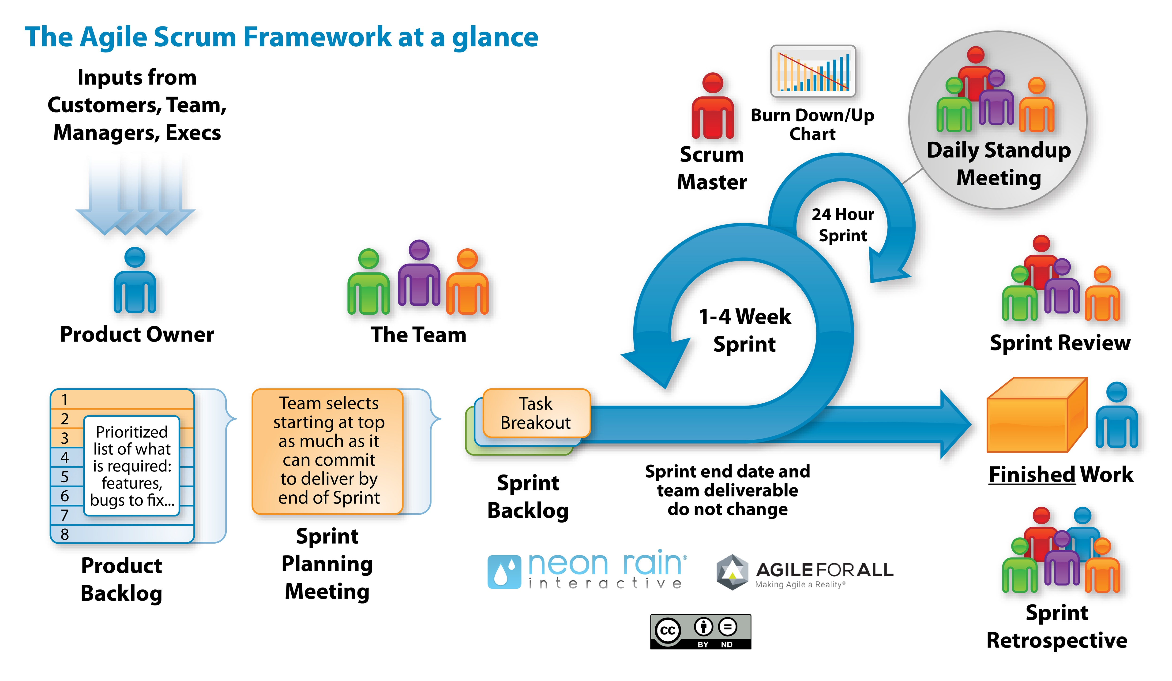
Scrum

Slide 14
Scrum Workflow Explained
Inputs → Product Owner
Scrum starts with inputs from customers, team members, managers, executives.
The Product Owner (PO) collects all these inputs and converts them into work items such as:
New features
Enhancements
Bug fixes
Technical requirements
These go into the Product Backlog.

Slide 15
Scrum Workflow Explained
Product Backlog
The Product Owner maintains a prioritized, ordered list of everything the product needs.
Examples:
Login feature
Fix API timeout bug
Add payment method
UI improvements
Important: The PO prioritizes based on business value.
Sprint Planning Meeting
The Team + Product Owner + Scrum Master meet to plan the next sprint.
During Sprint Planning:
The team looks at the top items from the Product Backlog.
The team chooses how much work it can commit to deliver in the upcoming sprint.
This selected work becomes the Sprint Backlog.
Sprint Backlog: A list of user stories selected for the sprint.

Slide 16
Scrum Workflow Explained
Sprint Backlog → Task Breakdown
After selecting user stories:
The team breaks each story into tasks.
Example:
User story: “Add product to cart”
Tasks:
Create API endpoint
Build UI
Write test cases
These tasks form the Sprint Backlog that the team will work on.

Slide 17
Scrum Workflow Explained
2–4 Week Sprint Cycle
The team now starts the Sprint, which lasts 1 to 4 weeks (common: 2 weeks).
Key rules:
The sprint duration is fixed.
The scope for the sprint does not change.
Only the team can decide whether they can add or remove items.
The picture shows this with the big loop arrow.

Slide 18
Scrum Workflow Explained
Daily Stand-up Meeting (24-Hour Cycle)
Every day, the team meets for 15 minutes to discuss:
What did I do yesterday?
What will I do today?
What blockers do I have?
Purpose: To ensure the team stays aligned and issues are removed quickly.
The Scrum Master facilitates these meetings.

Slide 19
Scrum Workflow Explained
Burn Down / Burn Up Chart
During the sprint:
The Scrum Master updates the Burndown chart.
It shows how much work is completed vs how much is remaining.
Helps track progress toward the sprint goal.
Sprint Review
At the end of the sprint:
The team demonstrates the completed work to the Product Owner and stakeholders.
Feedback is collected.
This helps refine the Product Backlog.
This is shown by the team presenting work in the image.

Slide 20
Scrum Workflow Explained
Finished Work
The work delivered in the sprint is:
Fully developed
Fully tested
Potentially shippable
Shown on the right side as Finished Work (box).
This becomes part of the product.
Sprint Retrospective
After the sprint review, the team meets internally to discuss:
What went well
What didn’t go well
What can be improved in the next sprint
Outcome:
Action items for continuous improvement.

Slide 21
Summary
Product Owner gathers and prioritizes ideas → Product Backlog
Team selects work → Sprint Planning
Work is broken into tasks → Sprint Backlog
Sprint begins (1–4 weeks)
Daily stand-up every 24 hours
Scrum Master ensures process + tracks burndown
End of sprint → Finished Work
Sprint Review with stakeholders
Sprint Retrospective with team
Cycle repeats with next Sprint

Slide 22
Scrum Roles
Scrum has 3 core roles:
Product Owner (PO):
Defines product vision and goals.
Manages the Product Backlog.
Prioritizes features and represents stakeholders/customers.
Scrum Master (SM):
Facilitates the Scrum process.
Removes impediments and ensures team follows Agile principles.
Acts as a servant leader for the team.
Development Team:
Cross-functional group (developers, testers, designers).
Self-organizing and responsible for delivering Sprint goals.

Slide 23
Product Owner (PO)
Role
The Product Owner is responsible for maximizing the value of the product and managing the Product Backlog.
Responsibilities
Defines the vision (e.g., “Allow users to order food from local restaurants easily”).
Creates and prioritizes user stories in the Product Backlog (e.g., login feature, restaurant listing, payment integration).
Communicates with stakeholders (marketing team, restaurant partners, investors).
Decides what gets built first based on business value.

Slide 24
Product Owner (PO)
The Product Owner decides that the first Sprint should focus on:
User registration and login
Basic restaurant list display
“As a user, I want to sign up with Google or email so I can quickly access the app.”

Slide 25
Scrum Master (SM)
Role
The Scrum Master acts as a facilitator and coach for the team. They ensure that Scrum principles are followed and remove obstacles.
Responsibilities
Conducts Scrum ceremonies: Daily Stand-up, Sprint Planning, Review, Retrospective.
Removes impediments (e.g., a developer is blocked due to missing API documentation).
Helps the team improve processes and stay self-organized.
Shields the team from external distractions.
Example (QuickBite App)
During Sprint 2, the developers face a delay because the API team hasn’t provided endpoints for restaurant data.
The Scrum Master arranges a quick sync meeting between the mobile and API teams to resolve it.

Slide 26
Development Team
Role
The Development Team builds the working product increment at the end of each Sprint.
Responsibilities
Selects work items for the Sprint (from backlog).
Designs, codes, tests, and delivers working features.
Participates in Sprint ceremonies.
Ensures quality and integration across components.
Example (QuickBite App)
During Sprint 3, the Development Team commits to:
Implementing “Add to Cart” and “Checkout” functionality.
Testing payment gateway integration.
At the end of the Sprint, they demo the working app in the Sprint Review.

Slide 27
Scrum Events (Ceremonies)
Scrum has 5 key events:
Sprint:
Time-boxed iteration (2–4 weeks).
Goal: deliver a usable product increment.
Sprint Planning:
Defines Sprint Goal and items to be completed.
Involves PO, SM, and Dev Team.
Daily Scrum (Stand-up):
15-minute daily meeting.
Each member answers:
What did I do yesterday?
What will I do today?
Any blockers?

Slide 28
Scrum Events (Ceremonies)
Sprint Review:
Held at end of Sprint to demonstrate completed work.
Stakeholders provide feedback.
Sprint Retrospective:
Reflects on what went well, what didn’t, and how to improve.

Slide 29
Sprint
Purpose
The Sprint is the heart of Scrum. It’s a fixed timebox (1–4 weeks) during which the team develops a working, usable product increment.
Example: Mobile Banking App
Let’s assume your team has planned a 2-week Sprint to develop:
“Login functionality”
“View account balance”
Activities within a Sprint
All other events (Planning, Daily Scrum, Review, Retrospective) occur within this Sprint.
The team works only on items defined in the Sprint Backlog.
No changes that endanger the Sprint Goal are made.
Output
A potentially shippable product increment, e.g.:
Users can log in securely and see their account balance.

Slide 30
Sprint Planning
Purpose
To define what can be delivered in the Sprint and how that work will be achieved.
Participants
Product Owner (defines priorities)
Scrum Master (facilitates)
Development Team (plans execution)
Example
Product Owner shows the top items in the Product Backlog:
Login with mobile number (high priority)
Account balance view
Fund transfer setup
Team discussion:
Developers assess effort → Login (5 story points), Balance View (8 points)
They commit to these two as achievable in 2 weeks.
They define a Sprint Goal:
“Enable users to securely log in and view their account balance.”
Output
Sprint Goal
Sprint Backlog (list of selected backlog items)
Initial plan for development

Slide 31
Daily Scrum (Daily Stand-up)
Purpose
A 15-minute daily meeting for the Development Team to inspect progress and plan for the next 24 hours.
Participants
Development Team (mandatory)
Scrum Master and Product Owner (optional observers)
Outcome
Team synchronizes and identifies blockers early — Scrum Master helps remove them (e.g., get security approval quickly).

Slide 32
Sprint Review
Purpose
Held at the end of the Sprint to inspect the increment and gather feedback from stakeholders.
Participants
Scrum Team (PO, SM, Dev)
Stakeholders (clients, managers, users)
Example
At the end of 2 weeks:
The team demos the new login and balance features.
Stakeholders test and give feedback:
“Can we add biometric login in future Sprints?”
“Add last login time on dashboard.”
Product Owner updates the Product Backlog accordingly:
Adds “Biometric login” as a new feature for next Sprints.
Output
Updated Product Backlog (with stakeholder feedback)
Improved understanding of customer needs

Slide 33
Sprint Retrospective
Purpose
To reflect on the past Sprint and identify ways to improve team collaboration, tools, or process.
Participants
Entire Scrum Team
Example
After the Sprint Review, the team meets privately:
What went well?
Daily Scrums helped communication.
Login module delivered on time.
What didn’t go well?
Test environment was set up late.
API documentation was unclear.
Improvements for next Sprint:
Prepare test environment before Sprint.
Improve API documentation using Swagger.
Output
Action items for process improvement (carried into next Sprint)

Slide 34
The 3 Pillars of Scrum
1. Transparency
Everyone involved in the project must have a clear and shared understanding of the work, goals, progress, and process. All key aspects of the product and process should be visible and understandable.
Purpose:
Transparency prevents misunderstandings and ensures all stakeholders have the same expectations.
How Scrum ensures it:
Use of Product Backlog, Sprint Backlog, and Definition of Done (DoD).
Daily Scrum and Sprint Review meetings keep progress visible.

Slide 35
The 3 Pillars of Scrum
2. Inspection
Regularly check progress toward the sprint and product goals to detect any deviations or issues early.
Purpose: Helps the team identify problems before they grow — ensuring continuous improvement.
How Scrum ensures it:
Daily Stand-up: Team inspects progress and blockers daily.
Sprint Review: The completed increment is inspected with stakeholders.
Retrospective: Team inspects how they worked and what can be improved

Slide 36
The 3 Pillars of Scrum
3. Adaptation
After inspection, the team adjusts the plan, tools, or approach to improve outcomes.
Purpose: To ensure the product and process continuously improve and respond to change.
How Scrum ensures it:
Backlog Refinement: Adjust priorities based on user feedback or market needs.
Sprint Retrospective: Adjust team processes for efficiency.
Next Sprint Planning: Modify plans based on what was learned.

Slide 37
Scrum Artifacts
Product Backlog:
Ordered list of all desired features, maintained by PO.
Constantly updated based on feedback.
Sprint Backlog:
Subset of Product Backlog items chosen for a specific Sprint.
Owned by the Development Team.
Increment:
The working, potentially shippable product at the end of the Sprint.
Must meet the Definition of Done (DoD).

Slide 38
Scrum Objectives
Deliver working software frequently.
Enable collaboration and transparency.
Emphasize customer satisfaction.
Encourage continuous improvement.
Respond quickly to change.
Foster self-organization and accountability.

Slide 39
Agile Metrics & Measurements
1. Velocity:
Measures work completed in a Sprint.
Helps in future Sprint planning.
2. Sprint Burndown Chart:
Tracks remaining work vs. time.
Visual representation of progress toward Sprint Goal.
3. Release Burndown Chart:
Tracks progress across multiple Sprints toward a release.
4. Lead Time & Cycle Time:
Lead Time: Time from request to delivery.
Cycle Time: Time from starting work to delivery.
5. Cumulative Flow Diagram (CFD):
Visualizes workflow stability and bottlenecks.
6. Escaped Defects:
Measures defects found after release.
7. Team Happiness / Satisfaction Index:
Gauges morale and engagement.

Slide 40
Agile Life Cycle
Concept – Identify need, feasibility.
Inception – Build initial team, define vision.
Iteration / Construction – Develop product incrementally.
Release – Deliver working product to customer.
Maintenance – Support and enhance product.
Retirement – End-of-life phase when product is no longer needed.

Slide 41
Benefits of Agile/Scrum
Faster time to market.
Better product quality.
High customer involvement.
Improved team morale and ownership.
Flexibility to adapt to change.
Continuous feedback and improvement.

Slide 42
Challenges in Agile
Resistance to change.
Lack of management support.
Poor backlog management.
Inadequate team collaboration.
Misunderstanding of Agile principles.
Over-commitment during Sprints.

Slide 43
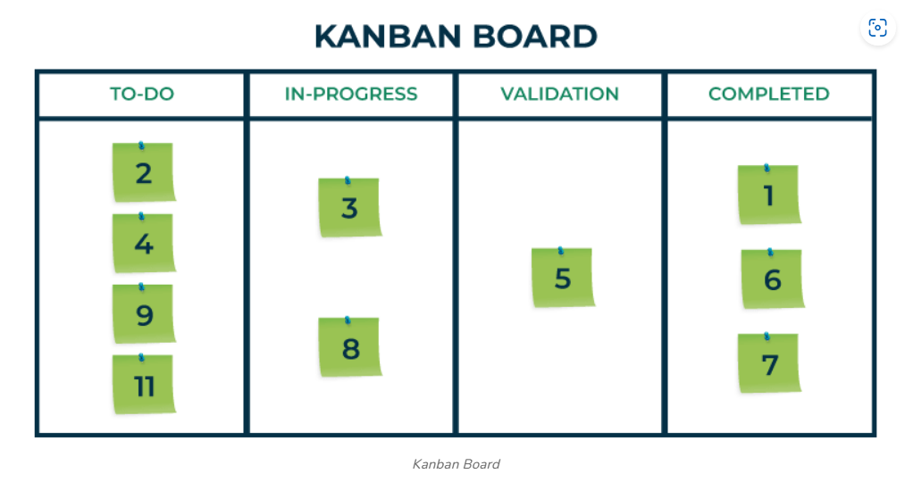

Slide 44
Kanban – Working Explained
Kanban is a visual workflow management method used to improve flow, reduce bottlenecks, and deliver work continuously.
It works on three main ideas:
Visualize the work
Limit work in progress (WIP)
Improve flow continuously

Slide 45
Kanban – Working Explained
A Kanban board usually has columns like:
To Do
In Progress
Review
Done
Teams place work items on cards and move them across the board as work progresses.
Example
A QA team has a Kanban board:
A bug card is placed in To Do
When a developer starts fixing it → moved to In Progress
When QA tests it → moved to Testing
After verification → moved to Done

Slide 46
Kanban – Working Explained
Limit Work in Progress (WIP Limits)
Kanban sets maximum items allowed in each column to avoid overload and bottlenecks.
Example
If In Progress has a WIP limit of 3:
The team cannot start new jobs until one of the 3 moves forward.
This ensures focus, quality, and faster delivery.
Manage and Improve Flow
Teams monitor cycle time (how long work takes), identify bottlenecks, and continuously improve the flow.
Example
If many items pile up in the Testing column:
It signals a bottleneck.
The team may assign more testers or simplify test steps.

Slide 47
When to use Kanban?
Support teams
QA teams working on daily bug fixes
Operations / DevOps teams
Any team needing continuous delivery instead of sprints
Short Summary
Kanban = Visual Board + WIP Limits + Continuous Flow
Shows work clearly
Prevents overload
Improves delivery speed and quality
Example: A development team moves tasks from To Do → In Progress → Code Review → Testing → Done, with limits to ensure smooth flow.

Slide 48
Kanban
Kanban is a visual workflow management method used to manage work efficiently through continuous delivery.
The word “Kanban” is Japanese and means “visual card” or “signal card”.
It originated from Toyota’s manufacturing system in the 1940s, used for Lean production.
In Agile, Kanban helps teams visualize work, limit work in progress (WIP), and improve flow.
Unlike Scrum, Kanban does not have time-boxed iterations (no Sprints). Work flows continuously

Slide 49
Core Principles of Kanban
Kanban is built on two main principles and six core practices.
Principles
Start with what you do now
No need to change your existing process immediately.
Kanban evolves gradually.
Pursue incremental, evolutionary change
Encourage continuous, small improvements instead of radical change.
Respect current roles and responsibilities
Kanban doesn’t mandate new roles or titles like Scrum does.
Encourage acts of leadership at all levels
Everyone contributes to process improvement — not just managers.

Slide 50
Core Practices of Kanban
1. Visualize the Workflow
Use a Kanban Board to show tasks and their progress.
Example board columns:
To Do → In Progress → Testing → Done
Each task is represented by a card (physical or digital).
2. Limit Work in Progress (WIP)
Restrict the number of tasks allowed in each stage.
Prevents overloading and ensures focus on finishing work.
Example:
“In Progress” column can have only 3 tasks at a time.

Slide 51
Core Practices of Kanban
3. Manage Flow
Monitor how work moves across the board.
Identify and remove bottlenecks.
Goal: achieve smooth, predictable flow.
4. Make Process Policies Explicit
Define clear rules for moving tasks between stages.
Example:
“A task can move to Testing only after peer review is done.”

Slide 52
Core Practices of Kanban
5. Implement Feedback Loops
Hold regular reviews or stand-up meetings to assess flow.
Example meetings:
Daily stand-ups, Operations review, Service delivery review.
6. Improve Collaboratively & Evolve Experimentally
Use data and metrics to identify improvements.
Encourage the team to experiment and adapt processes.

Slide 53
Kanban vs Scrum
Slide Title: Kanban vs Scrum Notes:
Summary:
Kanban is flow-based, while Scrum is iteration-based.
Kanban suits operational, support, or maintenance work.
Scrum suits feature-based or product development work.
Aspect | Kanban | Scrum
Iterations | Continuous flow | Time-boxed Sprints
Roles | No fixed roles | Scrum Master, PO, Team
Work Commitments | Pull-based | Sprint-based
Change During Work | Allowed anytime | Not allowed during Sprint
Metrics | Lead/Cycle Time | Velocity, Burndown
WIP Limit | Yes | Indirect (by Sprint capacity)

Slide 54
Kanban Metrics and Flow Measurements
Lead Time
Time taken from when a request is made to when it’s delivered.
Example: Customer requests a feature on Monday, delivered on Friday → Lead time = 5 days.
Cycle Time
Time taken from when work starts to when it’s completed.
Example: Work started on Tuesday, finished on Friday → Cycle time = 4 days.
Throughput
Number of work items completed per time period.
Example: “Team completed 15 tasks last week.”
Cumulative Flow Diagram (CFD)
Graph showing number of tasks in each state over time.
Helps visualize WIP, predictability, and bottlenecks.

Slide 55
Advantages of Kanban
Visual clarity of workflow
Flexibility – changes can be made anytime
Continuous delivery, no waiting for end of sprint
Reduces waste and bottlenecks
Focus on finishing work (not starting too many)
Data-driven improvement (using metrics like Lead Time)
Easy to adopt without changing existing roles/processes

Slide 56
Challenges of Kanban
No fixed deadlines → harder to predict release schedules
Requires team discipline to respect WIP limits
May lack structure for teams new to Agile
Risk of tasks stagnating in one column if flow is not managed
Continuous monitoring and collaboration needed

Slide 57
When to Use Kanban
When work is continuous and not time-boxed (e.g., maintenance, support).
When priorities change frequently.
When the team needs visual clarity and flow optimization.
When the team prefers evolutionary change over strict frameworks.
Examples:
IT Service Desk managing incident tickets.
QA Team tracking defects.
Marketing team managing campaign tasks.
DevOps team monitoring deployment requests.

Slide 58
Extreme Programming (XP)
XP (Extreme Programming) is an Agile software development framework that emphasizes technical excellence, continuous feedback, and high-quality code.
Created by Kent Beck in the late 1990s.
Designed for environments with frequent requirement changes and high technical risk.
XP improves software quality and responsiveness to changing requirements through strong engineering practices.

Slide 59
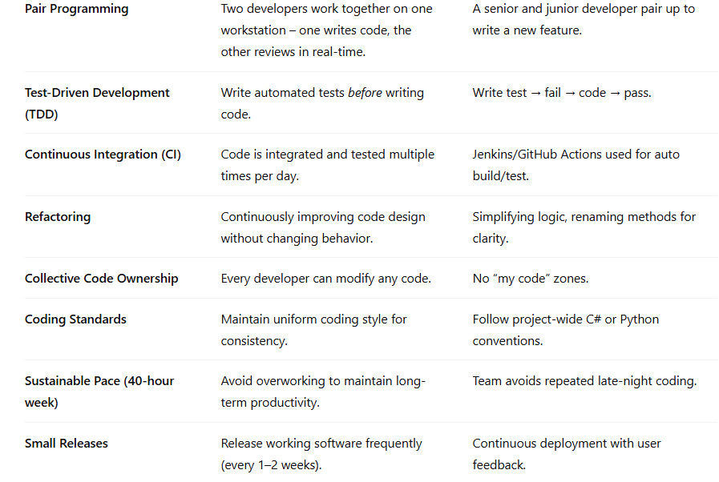
Key Practices of XP

Slide 60
Lean Software Development
Lean Agile is a mindset and framework that combines Lean principles (from manufacturing) with Agile values (from software development).
Goal: Deliver maximum value to customers with minimum waste and continuous improvement.
Inspired by the Toyota Production System (TPS) — originally used in manufacturing, then adapted to software and IT.
In Lean Agile, the focus is on:
Value delivery
Efficiency
Empowered teams
Continuous flow of work

Slide 61
The Philosophy Behind Lean Agile
Lean Agile focuses on doing more with less, by:
Understanding what the customer values.
Eliminating anything that doesn’t contribute to that value.
Encouraging team empowerment and flow.
Goal: Deliver the right product, at the right time, with the least effort and waste.

Slide 62
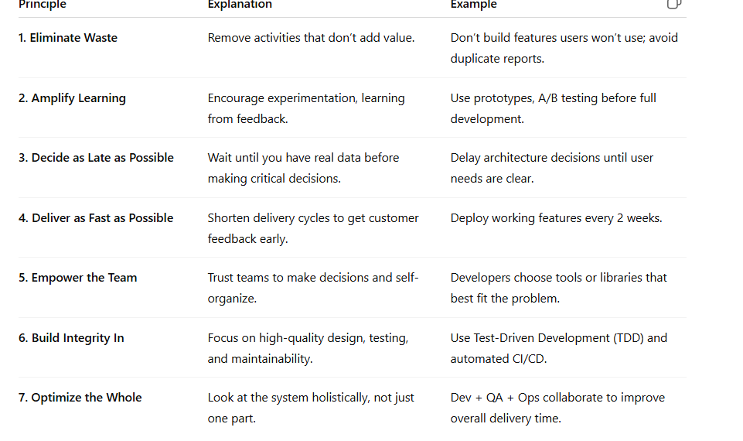
7 principles of LEAN

Slide 63
Lean Agile Process Flow
Identify Value → Understand customer needs.
Map the Value Stream → Identify all steps in delivery.
Create Flow → Eliminate bottlenecks and optimize sequence.
Establish Pull → Let teams pull new work when ready.
Pursue Perfection → Continuously improve every step
Example: A healthcare analytics team:
Maps their workflow for claim processing.
Identifies delays in QA testing as a bottleneck.
Automates regression tests.
Reduces delivery time from 3 weeks → 1 week.
Continuously measures improvement.

Slide 64
Real-World Examples of Lean Agile
Example 1: Toyota (Origin)
Introduced Just-In-Time (JIT) production.
Only produce what is needed when it’s needed.
Inspired the pull-based system in software.
Example 2: Amazon
Uses continuous deployment and small batch releases.
Teams deploy thousands of updates daily with automated pipelines.
Example 3: Spotify
Applies Lean-Agile mindset through Squads, Tribes, and Guilds.
Focuses on autonomous teams and continuous improvement.
Example 4: Healthcare Analytics
Team eliminates manual Excel reporting (waste) by building automated dashboards → value delivered faste

Slide 65
LEAN Explained
LEAN works through 5 main principles:
Identify Value
Understand what the customer truly needs.
Example
A customer needs:
A fast login process
Not a complex registration form
So the team focuses on improving the login speed.

Slide 66
LEAN Explained
Map the Value Stream
Visualize all steps from start to delivery
Identify which steps add value and which do not.
Example
Steps to fix a bug:
Log the bug
Assign to developer
Developer checks logs
Developer waits 2 days for server access → waste
Fix the bug
QA tests
The waiting step is waste and must be removed.

Slide 67
LEAN Explained
Create Flow
Ensure the work moves smoothly without interruptions or delays.
Example
A team automates code deployment so developers don’t wait for manual approvals. This creates a faster flow of work.
Establish Pull
Work is done when needed, not pushed unnecessarily.
Example
In Kanban, a developer takes a new task only when they finish the current one. No overload, no switching tasks.

Slide 68
LEAN Explained
Continuous Improvement (Kaizen)
Teams constantly find small ways to improve.
Example
Daily standups identify small wastes:
Slow testing? → Automate it
Too many bugs? → Improve code review
Delayed releases? → Improve CI/CD
Small improvements → Big impact.

Slide 69
Types of Waste In LEAN
LEAN removes wastes such as:
Waiting
Extra steps
Rework
Overproduction
Unnecessary movement
Too much inventory
Unused talent
Example
Waiting 3 days for requirement clarification = waste Fix: Product Owner must be available daily.

Slide 70
LEAN Summary
LEAN = Remove Waste + Deliver Value Faster + Continuous Improvement
Examples in IT:
Remove waiting → Faster approvals
Remove rework → Better requirements
Remove delays → Automate deployments
Improve flow → Use Kanban
LEAN makes teams faster, efficient, and high-quality.

Slide 71
SAFe (Scaled Agile Framework)
SAFe (Scaled Agile Framework) is a structured approach that helps large organizations implement Agile at enterprise scale.
It combines Lean, Agile, and DevOps principles to align teams, programs, and portfolios around common business goals.
Designed for enterprises where multiple Agile teams (50–1000+ people) must collaborate and deliver integrated solutions.
Key Objective: Deliver value faster and continuously, across the organization, while maintaining alignment, quality, and governance.
Example: A global healthcare analytics company with 20 Agile teams across departments uses SAFe to align all teams to a single “Enterprise Data Platform” roadmap.

Slide 72
Why SAFe?
Traditional Agile works well for small teams (5–10 members), but challenges arise at scale:
Multiple teams working on the same product.
Dependencies between teams.
Different priorities and lack of alignment.
Need for governance, compliance, and strategic planning.
SAFe addresses these by: Synchronizing multiple teams Aligning strategy with execution Ensuring built-in quality and governance Enabling enterprise agility

Slide 73
Key Events in SAFe
Event | Purpose | Example
PI Planning | Align all teams on goals for the next 8–12 weeks. | Teams plan features for “Patient Data Integration” for next PI.
Iteration Planning | Team-level sprint planning every 2 weeks. | Define sprint backlog.
System Demo | Show integrated work from all teams at end of iteration. | Demo full workflow from frontend to backend.
Inspect & Adapt (I&A) | Reflect and improve processes after each PI. | Identify quality or flow bottlenecks.
Scrum of Scrums (SoS) | Coordination meeting between teams. | Discuss dependencies across ART.
PO Sync | Align Product Owners across teams on priorities. | Ensure consistent backlog refinement.

Slide 74
Roles in SAFe
Notes:
Team Level
Scrum Master – Facilitates team ceremonies, removes blockers.
Product Owner – Manages team backlog and priorities.
Agile Team – Develops, tests, and delivers working software.
Program Level
Release Train Engineer (RTE) – “Chief Scrum Master” for ART; ensures coordination and flow.
Product Management – Defines vision and prioritizes Program Backlog.
System Architect/Engineer – Defines overall technical vision.
Portfolio Level
Lean Portfolio Management (LPM) – Aligns strategy, budgeting, and execution.
Epic Owners – Manage large-scale business initiatives.

Slide 75
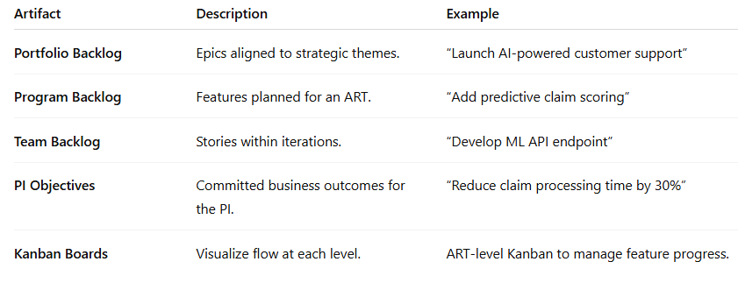
SAFe Work Artifacts

Slide 76
SAFe Explained
Define Business Strategy (Portfolio Level)
Leaders set:
Vision
Business goals
Budgets
Value streams (end-to-end flow of value)
Example: “Build a new digital healthcare platform in 2025.”

Slide 77
SAFe Explained
Create ARTs (Agile Release Trains)
An ART is a long-term team-of-teams (50–125 people) that delivers value together.
Includes developers, testers, architects, PO, SM, RTE
Works on the same mission
Operates on a fixed calendar (Program Increment)

Slide 78
SAFe Explained
Build the Program Backlog
The Product Management prepares features for the ART.
Features include:
Description
Business value
Acceptance criteria
Example: “Add online appointment scheduling.”

Slide 79
SAFe Explained
PI Planning (The Biggest SAFe Event)
Every 8–12 weeks, all teams meet (physically or virtually) to plan the next Program Increment.
Activities:
Understand the vision
Break features into stories
Identify dependencies
Create team plans
Commit to PI objectives
Outcome:
PI Objectives
Risks (ROAMed)
Program board

Slide 80
SAFe Explained
Execute Iterations (Sprints) Within the PI
Teams follow Scrum/Kanban to deliver stories.
Each iteration:
Iteration Planning
Daily Standups
Development + Testing
Iteration Review
Iteration Retrospective
Teams demo working features every 2 weeks.

Slide 81
SAFe Explained
System Demo (End of Every Iteration)
All teams show integrated work to stakeholders.
Purpose:
Ensure features work end-to-end
Get fast feedback
Inspect & Adapt (End of PI)
A larger retrospective for the entire ART.
Includes:
PI demo
Quantitative metrics
Problem-solving workshop
Improvement action items
Goal: Continuous improvement across the whole organization.

Slide 82
SAFe Explained
Release Value (On-Demand)
SAFe allows releasing anytime during or after the PI when the work is ready.
Examples:
Deploy a new feature to customers
Release an internal tool
Continuous Learning Culture
SAFe promotes:
Lean thinking
DevOps
Continuous delivery pipelines
Innovation time (IP Iteration)

Slide 83
SAFe Explained - Summary
Define strategy and value streams
Form Agile Release Trains (ARTs)
Prepare program backlog with features
Conduct PI Planning (plan 8–12 weeks)
Execute sprints and deliver stories
Show integrated work in system demos
Inspect & Adapt at end of PI
Release value on-demand
Continuously improve

